Slide 1

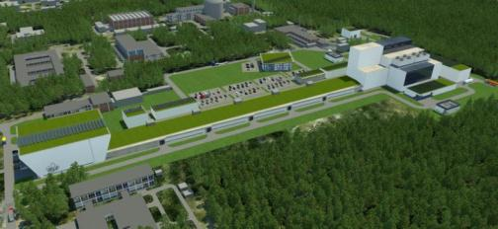
MYRRHA
Multipurpose hYbrid Research Reactor for High-tech Applications
Contributing to the 3rd Pillar of the European Strategy for HLW Mgt through P&T
Open for international participation
Marc Schyns
SCK•CEN, Boeretang 200, 2400 Mol, Belgium
mschyns@sckcen.be or myrrha@sckcen.be
3th European Energy Conference – 28-30 October 2013 – Budapest

Slide 2

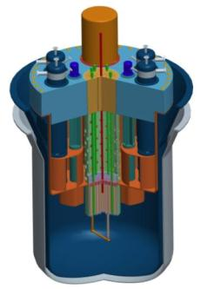
MYRRHA - Accelerator Driven System
Accelerator
(600 MeV - 4 mA proton)
Reactor
Subcritical or Critical modes
65 to 100 MWth
Innovative & Unique
Spallation Source
Multipurpose
Flexible
Irradiation
Facility
Fast
Neutron
Source
Lead-Bismuth
coolant

Slide 3
MYRRHA Accelerator Challenge
fundamental parameters (ADS)
particle | p
beam energy | 600 MeV
beam current | 4 mA
mode | CW
MTBF | > 250 h
challenge !
failure = beam trip > 3 s
implementation
superconducting linac
frequency | 176.1 / 352.2 / 704.4 MHz
reliability = redundancy | double injector
 | “fault tolerant” scheme

Slide 4
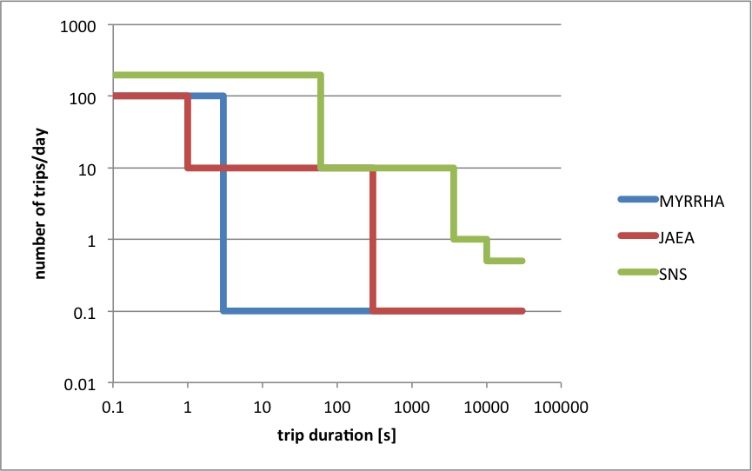
About beam trips

Slide 5
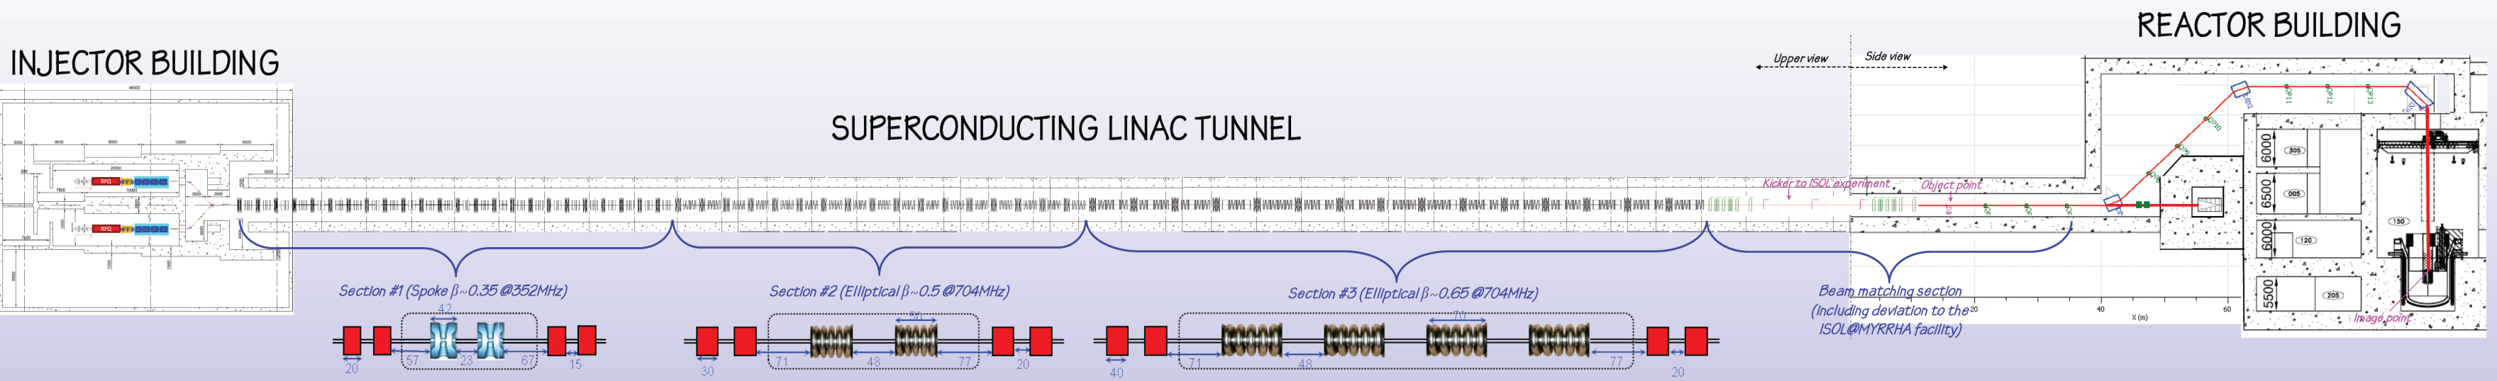
MYRRHA linac

Slide 6
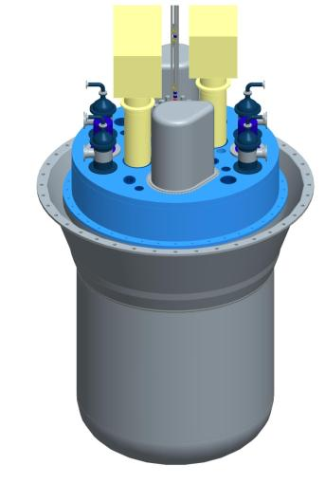
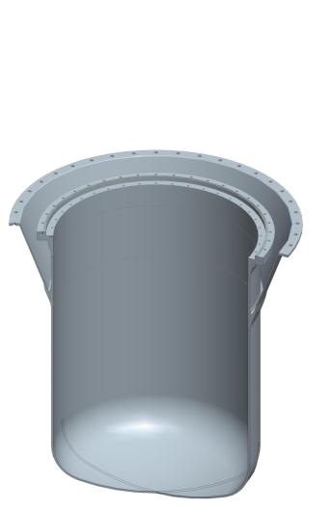
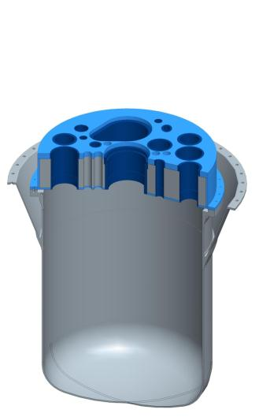
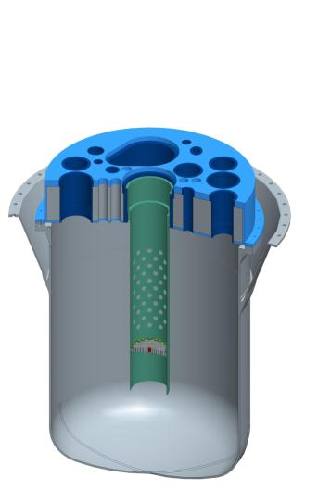
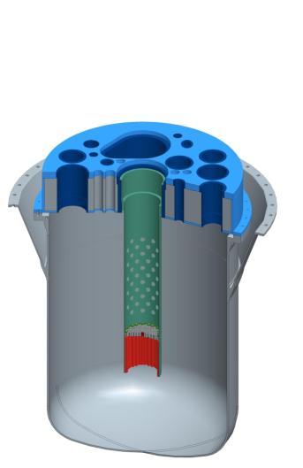
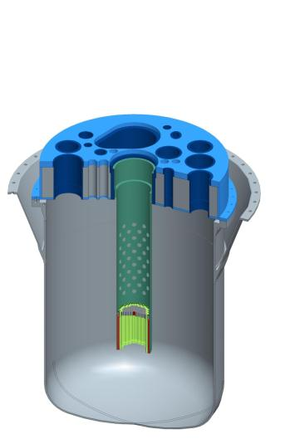
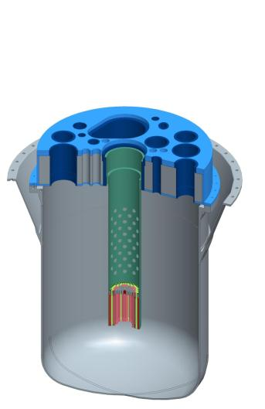
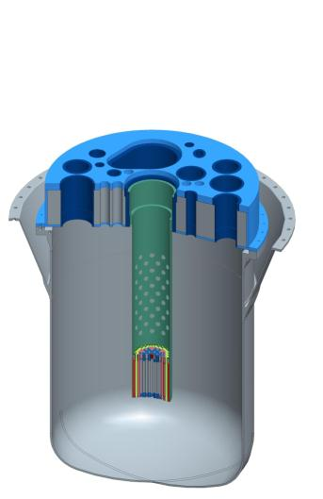
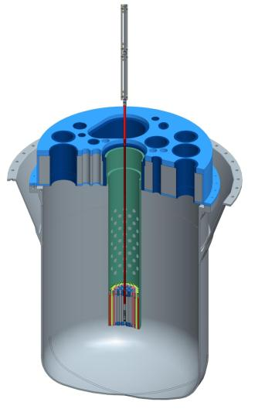

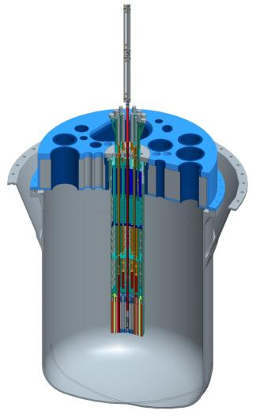

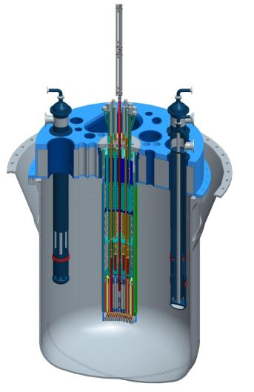
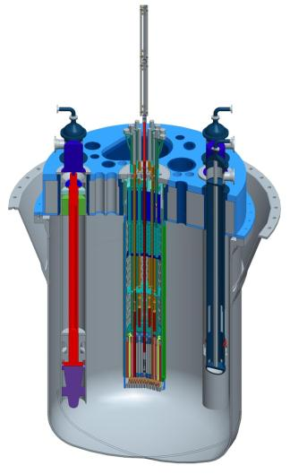
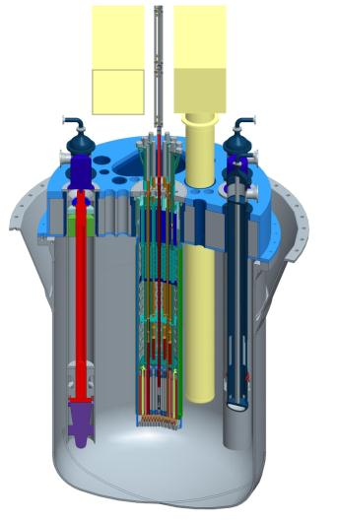
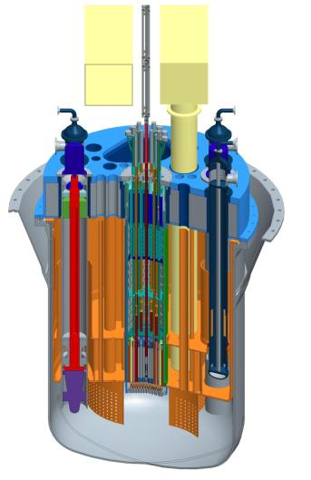
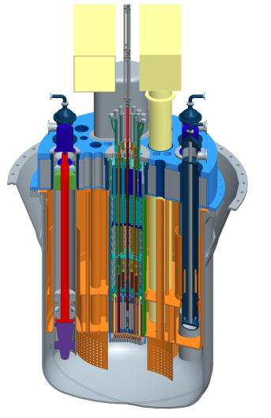
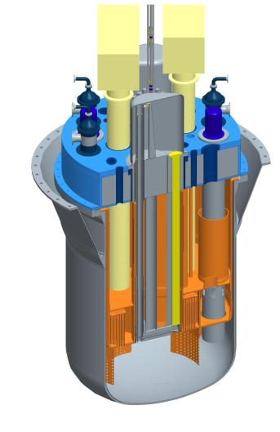
Reactor layout
Reactor Vessel
Reactor Cover
Core Support Structure
  Core Barrel
  Core Support Plate
  Jacket
Core
  Reflector Assemblies
  Dummy Assemblies
  Fuel Assemblies
Spallation Target Assembly and Beam Line
Above Core Structure
  Core Plug
  Multifunctional Channels
  Core Restraint System
Control Rods, Safety Rods, Mo-99 production units
Primary Heat Exchangers
Primary Pumps
Si-doping Facility
Diaphragm
  IVFS
IVFHS
  IVFHM

Slide 7
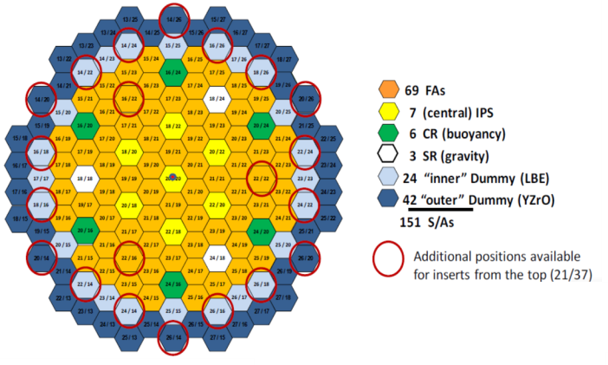
Core and Fuel Assemblies
151 positions
37 multifunctional plugs

Slide 8
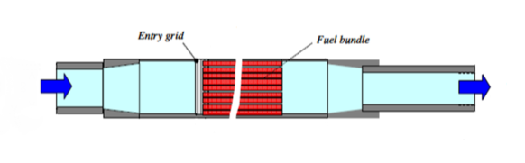
Core and Fuel Assemblies
Fuel
  Cladding in 15-15 Ti
  Wire wrap
  Wrapper in T91

Slide 9

Cooling systems
Decay heat removal (DHR) through secondary loops
  4 independent loops
  redundancy (each loop has 100% capability)
  passive operation (natural convection in primary, secondary and tertiary loop)
Ultimate DHR through RVCS (natural convection)

Slide 10
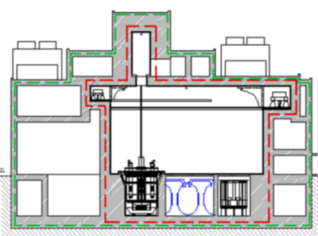
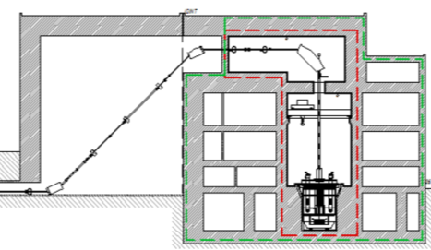
Integration into building

Slide 11
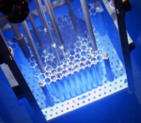

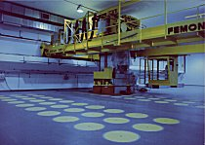

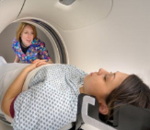

Multipurpose facility
ADS demonstration & P&T Research
Fuel research
Φ_{tot} = 0.5 to 1.10¹⁵ n/cm².s
Φ = 1 to 5.10¹⁴ n/cm².s
(ppm He/dpa ~ 10)
in medium-large volumes
Material research
Φ_{Fast} = 1 to 5.10¹⁴ n/cm².s
(En>1 MeV) in large volumes
Fission GEN IV
Fusion
Multipurpose
hYbrid
Research
Reactor for
High-tech
Applications
High energy LINAC
600 MeV – 1 GeV
Long irradiation time
50 to 100 MWth
Φ_{Fast} = ~10¹⁵ n/cm².s
(En>0.75 MeV)
Waste
Fundamental
research
Φ_{th} = 0.5 to 2.10¹⁵ n/cm².s
(En<0.4 eV)
Φ_{th} = 0.1 to 1.10¹⁴ n/cm².s
(En<0.4 eV)
Radio-
isotopes
Silicon
doping

Slide 12
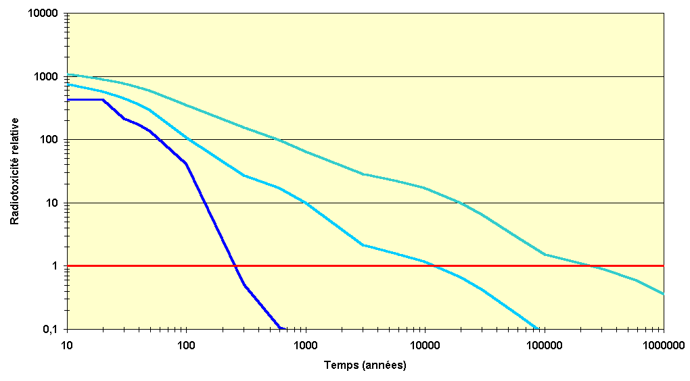


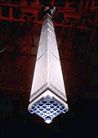


Motivation for transmutation
transmutation
of spent fuel
spent fuel reprocessing
no reprocessing
Relative radiotoxicity
Uranium
naturel
Time (years)
Duration Reduction 1.000x
Volume Reduction 100x

Slide 13
European Strategy for P&T
The implementation of P&T of a large part of the high-level nuclear wastes in Europe needs the demonstration of its feasibility at an “engineering” level. The respective R&D activities could be arranged in four “building blocks”:
  Demonstration of the capability to process a sizable amount of spent fuel from commercial LWRs in order to separate plutonium (Pu), uranium (U) and minor actinides (MA),
  Demonstration of the capability to fabricate at a semi-industrial level the dedicated fuel needed to load in a dedicated transmuter (JRC/ITU),
  Design and construction of one or more dedicated transmuters,
  Provision of a specific installation for processing of the dedicated fuel unloaded from the transmuter, which can be of a different type than the one used to process the original spent fuel unloaded from the commercial power plants, together with the fabrication of new dedicated fuel.

Slide 14
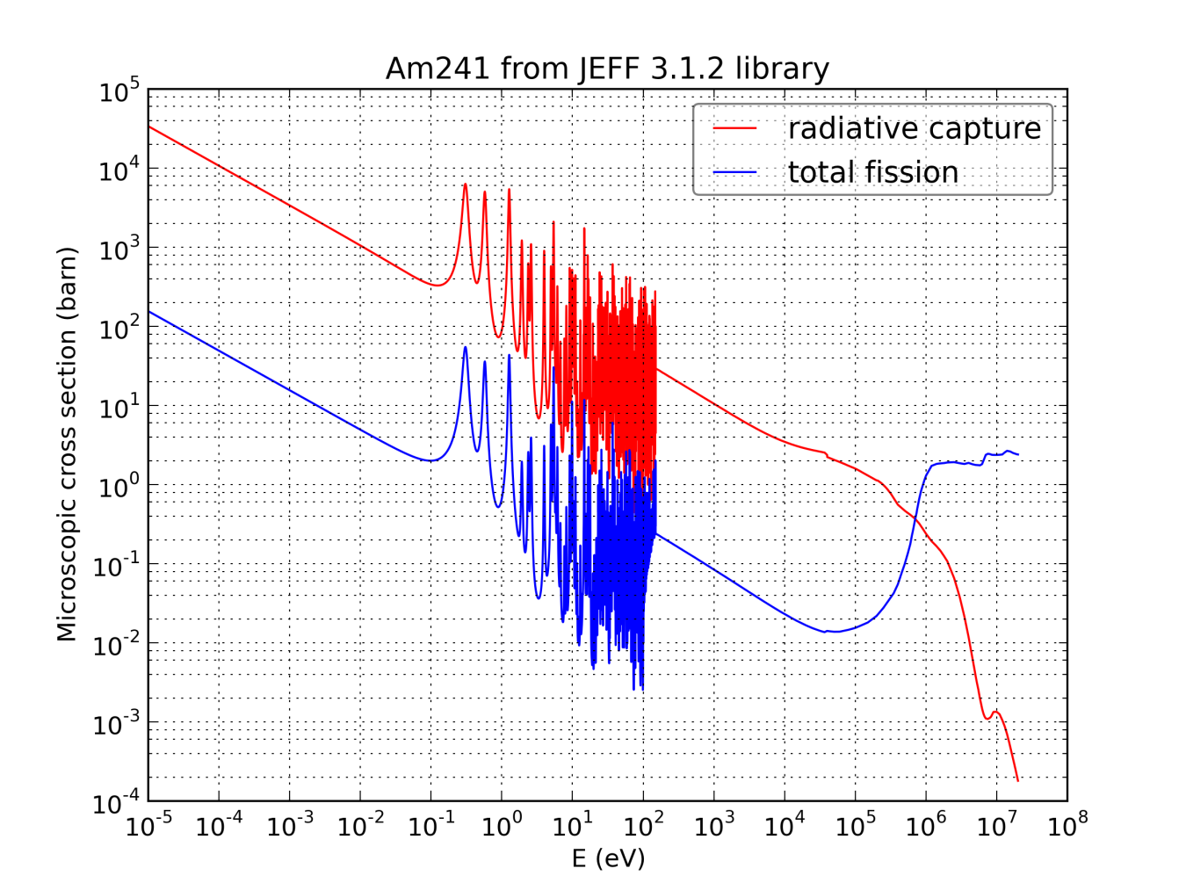
Fast Neutron are unavoidable for transmutation
To transmute MAs, we need to fission them
The ration Fission/Capture is more favourable with fast neutrons

Slide 15
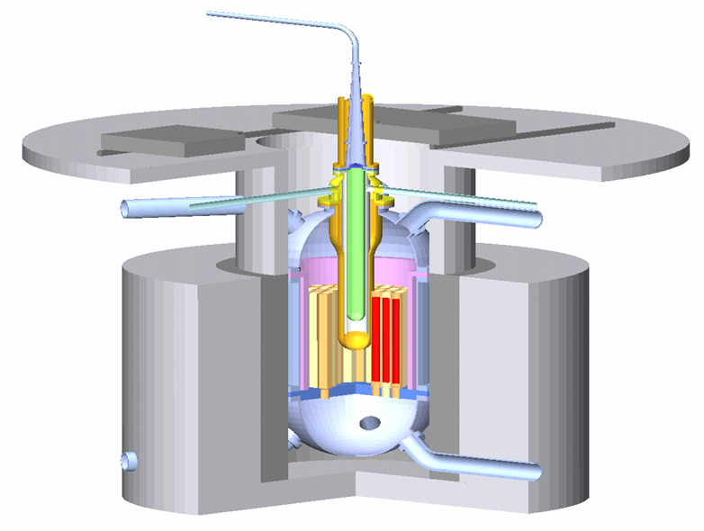
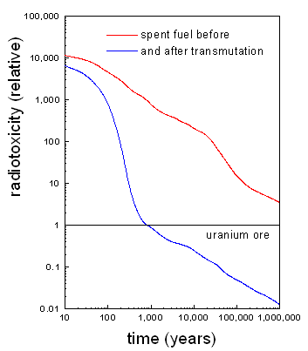
Is sub-criticality a luxury?
Both Critical reactors as well as ADS can be used as MAs transmuters
Nevertheless, critical reactors, heavily loaded with MAs, can experience severe safety issue due to reactivity effet induced by a smaller fraction of delayed neutrons.
ADS can operate in a more flexible and safer manner even if heavily loaded with MAs hence leading to efficient transmutation therefore we say that sub-criticality is not a luxury but a necessity.
accelerator
Proton Beam
Spallation Target

Slide 16
Why sub-criticality is needed
p
n
Subcritical
Neutron
Multiplier
Proton
Accelerator
Spallation
Source
ADS is presently studied for the MAs transmutation due to their smaller fraction of delayed neutrons and their impact of the kinetics parameters of the reacteur
²³⁵U 650 pcm ²³⁸U 1480 pcm
²³⁸Pu 120 pcm ²³⁹Pu 210 pcm
²⁴⁰Pu 270 pcm ²⁴¹Pu 490 pcm
²⁴²Pu 573 pcm ²³⁷Np 334 pcm
²⁴¹Am 113 pcm ²⁴³Am 208 pcm
²⁴²Cm 33 pcm ²⁴⁴Cm 100 pcm
If one wants to have a heavily loaded core (>10%), one needs to considère ADS

Slide 17
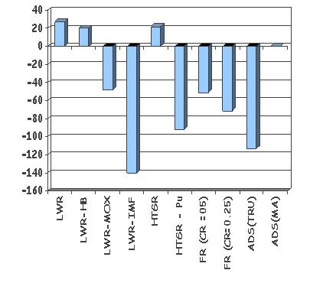
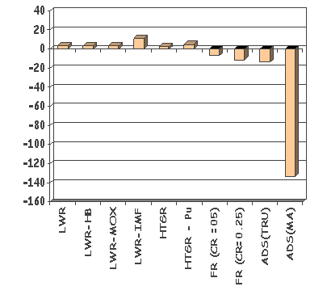
ADS is the most efficient system for burning MAs
Pu Production Rate (grams / GWh)
MA Production Rate (grams / GWh)
* Mike Cappiello, (LANL), “The Potential Role of Accelerator Driven Systems in the US”, ICRS-10/RPS’2004, Madeira (PT), 2004

Slide 18
Even with completely different national NE policies
European solution for HLW works with ADS
SHARED
Advantages for A
ADS shared with B
ADS burn A’s Pu& MA
Smaller Fu-Cycle units & shared
Scenario 1 objective: elimination of A’s spent fuel by 2100
A = Countries Phasing Out, B = Countries Continuing

Slide 19
But MYRRHA is more than research on
ADS & Transmutation

Slide 20
Multipurpose facility
Fuel research
Φ_{tot} = 0.5 to 1.10¹⁵ n/cm².s
Φ = 1 to 5.10¹⁴ n/cm².s
(ppm He/dpa ~ 10)
in medium-large volumes
Material research
Φ_{Fast} = 1 to 5.10¹⁴ n/cm².s
(En>1 MeV) in large volumes
Fission GEN IV
Fusion
Multipurpose
hYbrid
Research
Reactor for
High-tech
Applications
High energy LINAC
600 MeV – 1 GeV
Long irradiation time
50 to 100 MWth
Φ_{Fast} = ~10¹⁵ n/cm².s
(En>0.75 MeV)
Waste
Fundamental
research
Φ_{th} = 0.5 to 2.10¹⁵ n/cm².s
(En<0.4 eV)
Φ_{th} = 0.1 to 1.10¹⁴ n/cm².s
(En<0.4 eV)
Radio-
isotopes
Silicon
doping

Slide 21
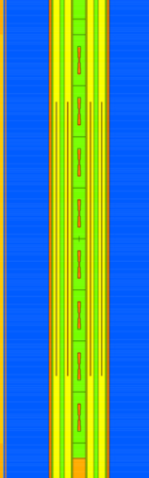
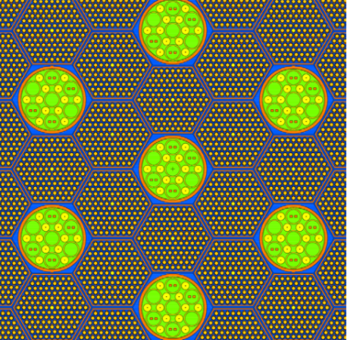
Material Irradiation Performances for FRs
Critical@100 MW
 | IPS in Chan [0 0 0] |  | IPS in Chan [2 0 0]
Sample n° | dpa/EFPY | Φ_{tot} | dpa/EFPY | Φ_{tot}
8 | 18.1 | 2.38E+15 | 16.2 | 2.12E+15
7 | 23.0 | 2.85E+15 | 20.7 | 2.54E+15
6 | 25.9 | 3.19E+15 | 23.3 | 2.85E+15
5 | 27.5 | 3.37E+15 | 24.5 | 3.02E+15
4 | 27.2 | 3.39E+15 | 24.5 | 3.03E+15
3 | 25.7 | 3.23E+15 | 22.9 | 2.89E+15
2 | 22.3 | 2.92E+15 | 19.9 | 2.62E+15
1 | 17.3 | 2.50E+15 | 15.5 | 2.23E+15

Slide 22
Irradiation capabilities of IPS for FR Reactors
Sub-critical @ 73 MW
IPS | Total flux, n/(cm²s) | Fast (> 0.75 MeV) flux, n/(cm²s) | Radiation damage, DPA/FPY | Helium production, appm/FPY | Ratio appm He/DPA
1 | 2.64×10¹⁵ | 4.20×10¹⁴ | 22.3 | 7.66 | 0.343
2 | 2.72×10¹⁵ | 4.29×10¹⁴ | 23.0 | 10.41 | 0.452
3 | 2.75×10¹⁵ | 4.29×10¹⁴ | 23.1 | 5.94 | 0.257
4 | 2.72×10¹⁵ | 4.18×10¹⁴ | 22.5 | 6.59 | 0.293
5 | 2.70×10¹⁵ | 4.35×10¹⁴ | 22.7 | 6.52 | 0.288
6 | 2.68×10¹⁵ | 4.23×10¹⁴ | 22.8 | 10.78 | 0.474

Slide 23
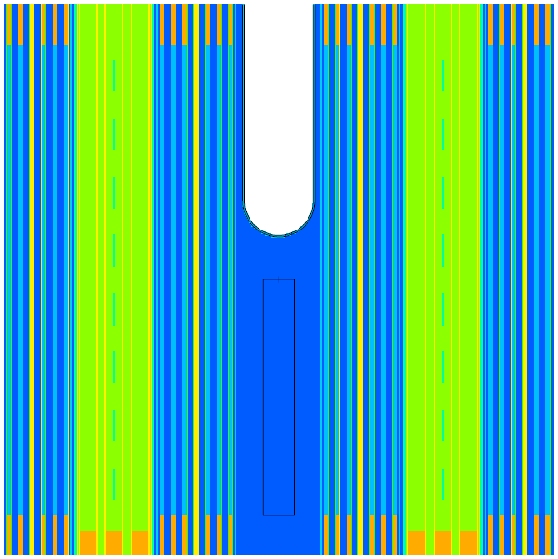
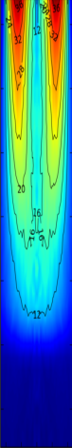
Prepare the path for Fusion DEMO
Irradiation capabilities under spallation target
+10 cm
0 cm
-30 cm

Slide 24
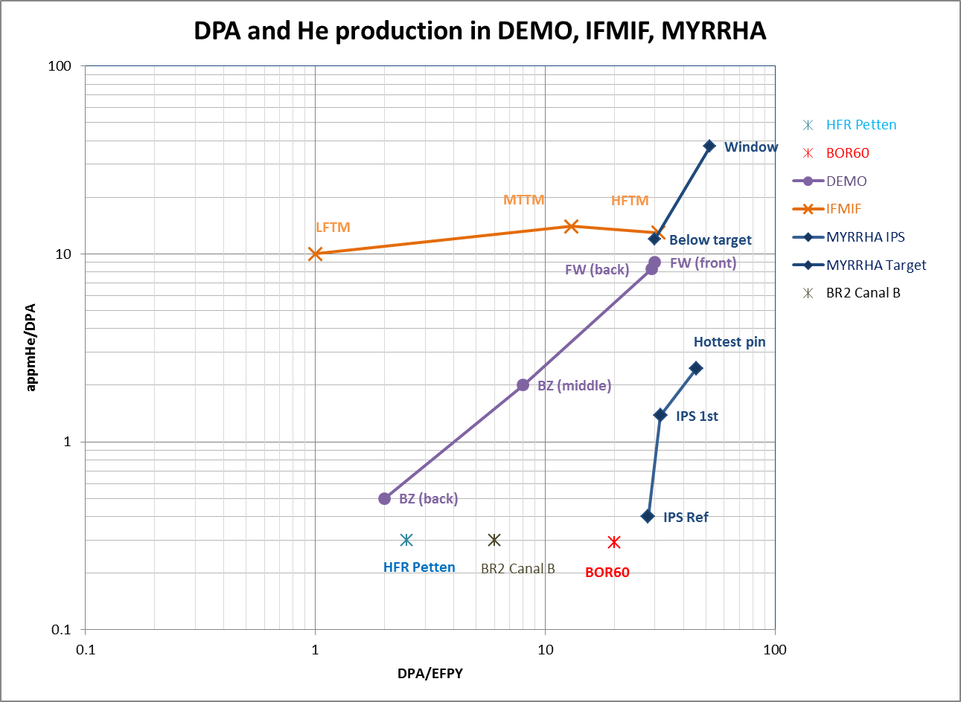
MYRRHA for fusion material irradiations
Estimated damage induced in DEMO and proposed
irradiation conditions in IFMIF and MYRRHA-IMIFF

Slide 25
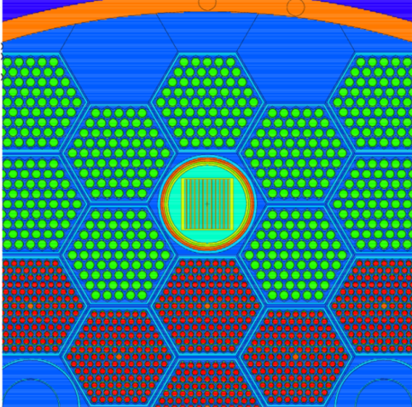

Radioisotope (Mo-99) production capability
Sub-critical @ 73 MW
Average specific power
173 W/cm²
184 W/cm²
171 W/cm²

Slide 26
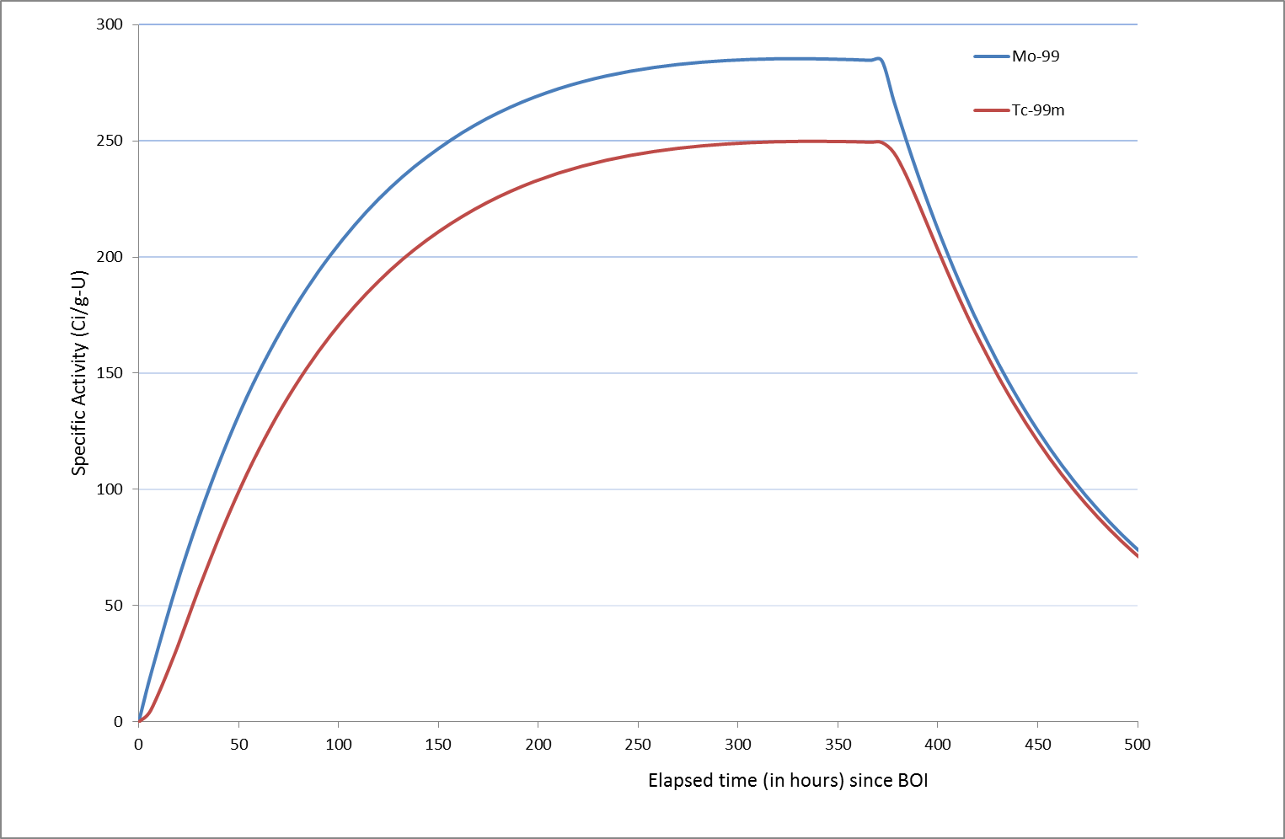
Radioisotope (Mo-99) production capability
Critical @ 100 MW
Heat flux ≤ 400 W/cm²

Slide 27
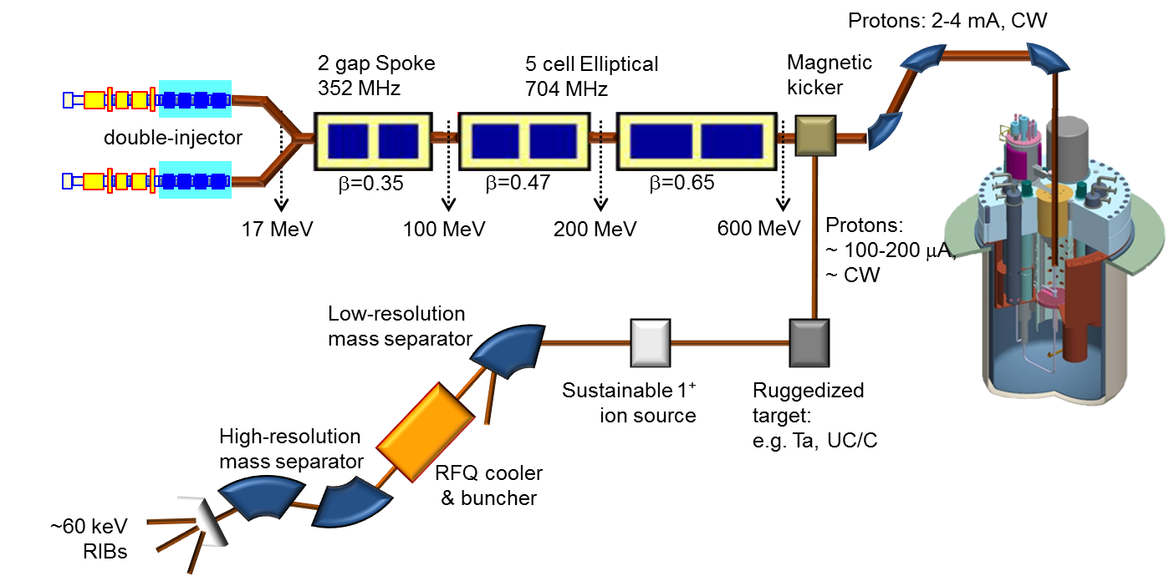

MYRRHA - Concept
MYRRHA for fundamental research
ISOL@MYRRHA - Concept
MYRRHA - Concept
thin refractory metal foils
carbide powders
liquid targets
surface ion source
ECR ion source
RILIS

Slide 28
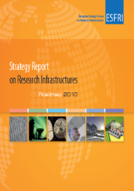
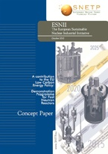

MYRRHA in the European Context
Knowledge
Economy
Energy
Independence
ESFRI
European Strategic Forum for Research Infrastructure
SET Plan
European Strategic Energy Plan
27.11.2010
Confirmed on ESFRI
priority list projects
15.11.2010
in ESNII
(SNETP goals)

Slide 29
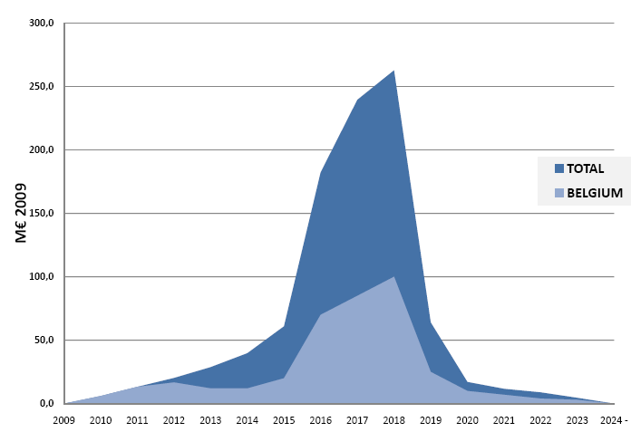
Belgian commitment: secured
International consortium: under construction
2nd phase (11 y)
others 576 M€
960 M€
(2009)
Consortium
Belgium 324 M€
(36 M€/y x 9 y)
Belgium 60 M€
(12 M€/y x 5 y)

Slide 30

The project schedule
Executing presently the FEED Phase: 2010-2014/15
2010-2014
Front End
Engineering
Design
2015
Tendering &
Procurement
2016-2018
Construction of
components &
civil engineering
2019
On site
assembly
2020-2022
Commissioning
2023
Progressive
start-up
2024-
Full
exploitation
Minimise technological risks
Secure the licensing
Secure a sound management and investment structure
PDP
preliminary
dismantling
plan
PSAR
preliminary
safety
assesment
EIAR
environmental impact
assesment
FEED
(Front End
Engineering
Design)
Central
Project
Team
Owner
Consortium
Group
Owner
Engineering
Team
2010-2014/15

Slide 31


















































MYRRHA R&D open for international collab.
Notes:
31

Slide 32


MYRRHA Project open for International Participation
INVESTMENT PHASE
Primary «investors»
Participation vehicle
(Consortium members)
Contribution to investment capital
(960 M€’09)
«ERIC» ^{(*)}
IPR
management rules tbd
Belgian Federal Ministry
of Energy
(50%)
SCK•CEN
(on behalf of Belgian
Federal
Government)
BE
40 %
Belgian Federal Ministry
of Science Policy (50%)
Major European partners
EU country
Public foundation
EU countries
A major Asian partner
Asian country
Asian country
EU FP7 (RTD) / SET-Plan (Energy)
EU participation
EU
ROW
ROW participation
ROW
(*) European Research Infrastructure Consortium

Slide 33
Conclusions
MYRRHA As a Multipurpose Fast Spetrum irradiation facility selected by ESFRI, is responding to:
  The issue of addressing the nuclear waste legacy of present reactor technology through advance options (ADS, P&T)
  The SNETP need for a multipurpose research infrastructure expressed in its Strategic Research Agenda whatever the considered technology for Gen.IV systems
  The Objective of Belgium and SCK•CEN to maintain a high level expertise in the country in the nuclear safety, nuclear technology and nuclear competencies independently of the future of NE
  The objective of the European Commission to make available a series of relevant irradiations facilities for the fusion material research community towards the DEMO construction
  Secure society needs for RI for medical applications and Dopped-Si for renewable Energy

Slide 34
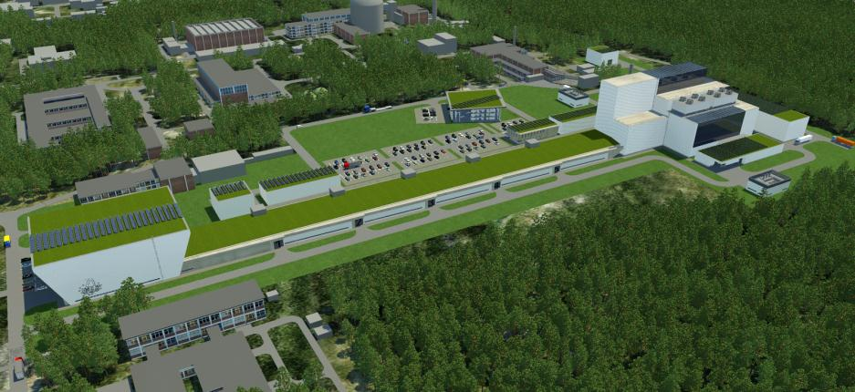
MYRRHA: EXPERIMENTAL ACCELERATOR DRIVEN SYSTEM
A pan-European, innovative and unique facility at Mol (BE)
BR2 reactor
(existing)
Utilities
buildings
MYRRHA reactor
building
MYRRHA LINAC
high energy tunnel
ECR source & Injector Building

